Slide 1
Naive Bayes

Slide 2
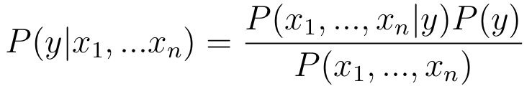
Bayes Theorem
Notes:
Photo: https://www.flickr.com/photos/107442568@N08/12547327134

Slide 3
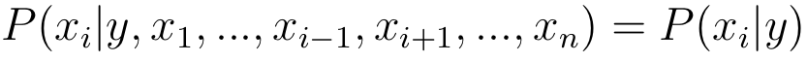
Bayes Theorem
Naive assumption
feature independence
Notes:
Photo: https://www.flickr.com/photos/107442568@N08/12547327134

Slide 4
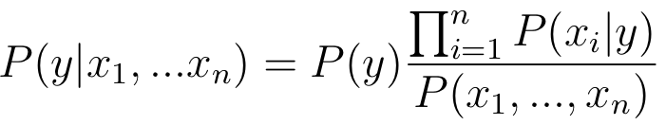
Bayes Theorem
Naive assumption
feature independence
Notes:
Photo: https://www.flickr.com/photos/107442568@N08/12547327134

Slide 5
Bayes Theorem
Naive assumption
feature independence
Denominator is constant given our training data
P(y) is class occurrences & like
we can get it from training data
Notes:
Photo: https://www.flickr.com/photos/107442568@N08/12547327134

Slide 6
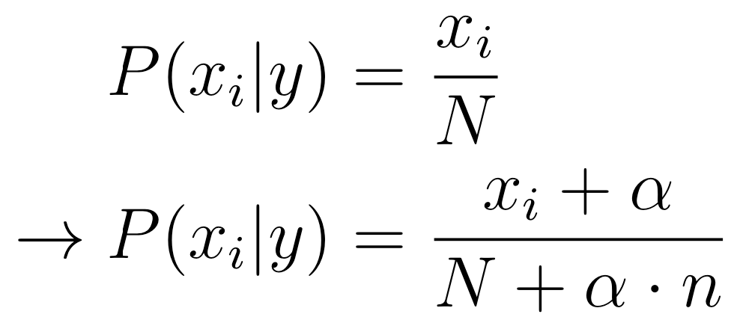
Additive Smoothing
When, in testing or validation, we get a unseen value of a feature
n = number of features
N = number of observations
number of occurrences of value i
Notes:
Photo: https://www.flickr.com/photos/107442568@N08/12547327134

Slide 7
Naive Bayes Applications
Requires only small amounts of training data
Spam classification
predict_proba not particularly accurate
Notes:
Photo: https://www.flickr.com/photos/107442568@N08/12547327134

Slide 8
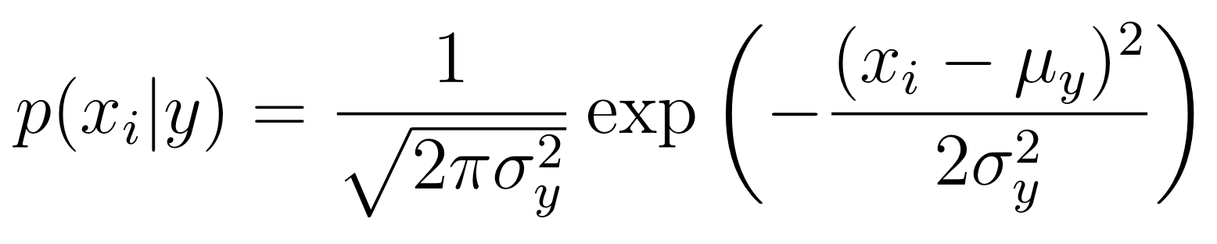
Gaussian Naive Bayes
Assumes features are distributed in a Gaussian nature within each class
Mean and standard deviation of x_i in each class, y
Get probability based on gaussian distribution
Notes:
Photo: https://www.flickr.com/photos/107442568@N08/12547327134

Slide 9
Other Naive Bayes models
Make different assumptions about
Multinomial, bernoulli, ...
Notes:
Photo: https://www.flickr.com/photos/107442568@N08/12547327134

Slide 10
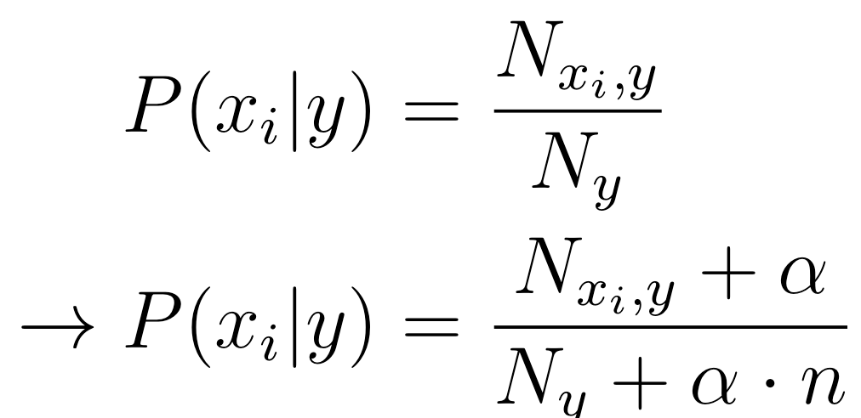
Other Naive Bayes models
Make different assumptions about
Multinomial, bernoulli, ...
Notes:
Photo: https://www.flickr.com/photos/107442568@N08/12547327134

Slide 11
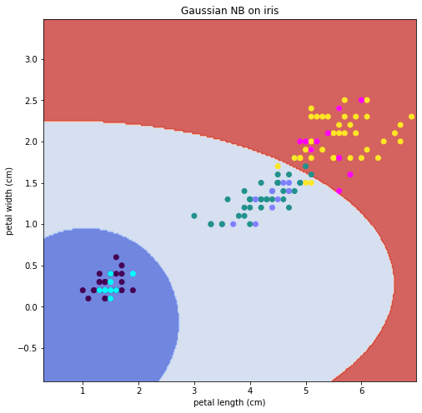
Gaussian Naive Bayes
Notes:
Photo: https://www.flickr.com/photos/107442568@N08/12547327134

Slide 12
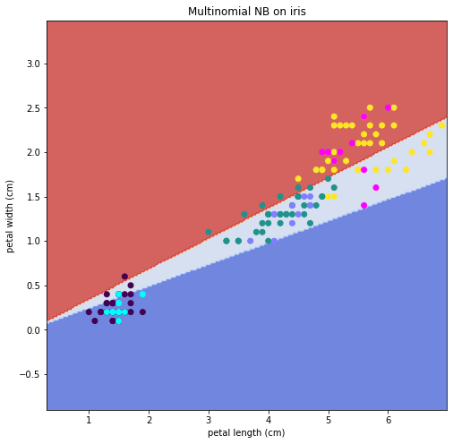
Multinomial Naive Bayes
Notes:
Photo: https://www.flickr.com/photos/107442568@N08/12547327134

